Slide 1
Computational Thinking, Problem Solving, and Programming
TOPIC 4.0 – Computational thinking
TOPIC 4
Debug Day

Slide 2


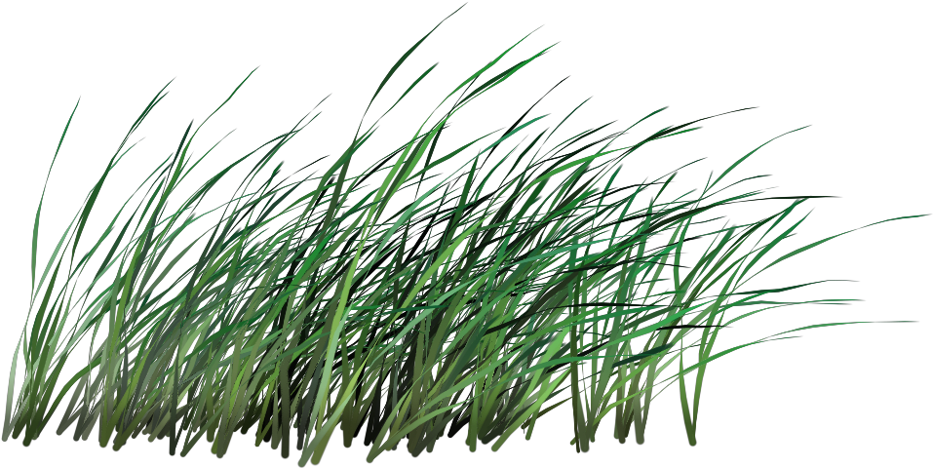
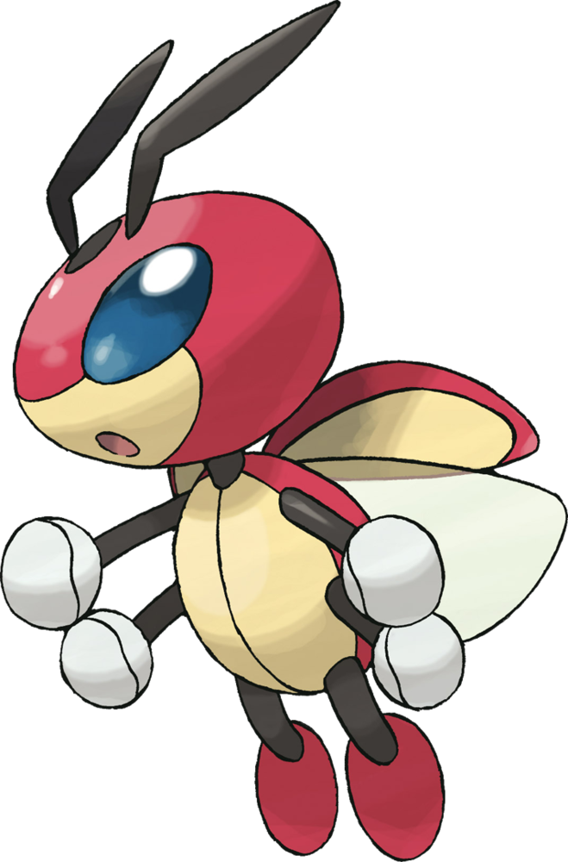
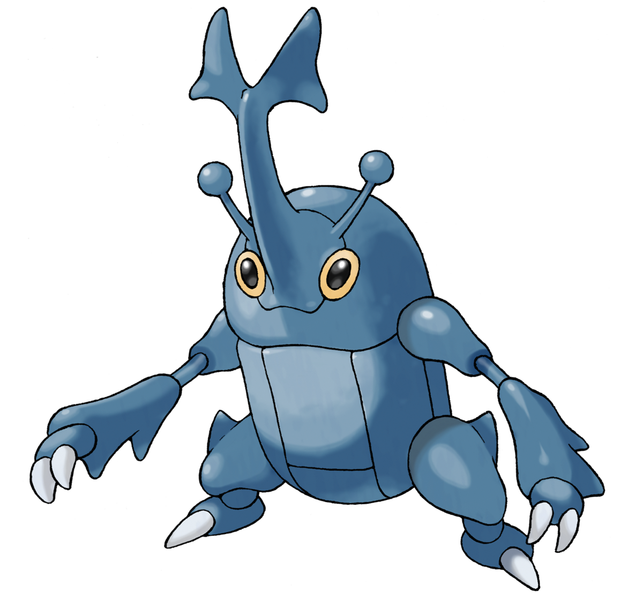

DEBUG DAY
It’s a jungle out there
Welcome to Debug Forest, where the code is as buggy as the trees
We’ll be helping to rid the forest of its code bugs
Hopefully not the real ones, as those contribute to the ecosystem in important ways
You’ll be given code and tasked with finding and fixing the bugs in it

Slide 3
DEBUG DAY
PROBLEM ONE
#program to find the X in a 2D list of strings
#initializing the lists
list = [["A","C","B","Z","J"],
["U","I","J","X","O"],
["B","F","U","W","L"],
["P","O","T","L","W"],
["T","H","E","H","O"]]
#looping through the list
for i in range(0, len(list)):
if list[i][i] == "X":
print("X found at ", i, ",", i)

Slide 4

DEBUG DAY
PROBLEM TWO
#this program is intended to detect if a subword is part of a given word
word = "supercalifragilisticexpialidocious"
#getting user desired subword
subword = int(input("Enter a word that you want to check if is a subword: "))
#checking where the subword starts at if it starts at all
for i in range (0,len(subword)):
if word[i:len(subword)] == subword:
print("It contains it starting at character: ", i)

Slide 5


DEBUG DAY
PROBLEM THREE
#this code describes how many elements from list 1 appear in list 2
list = [3, 5, 19, 100, 53, 22, 89, 68, 17, 33]
list2 = [5, 99, 98, 100, 17, 2, 4, 6, 9, 0]
#finds if each element of list is found in list2
for i in range(0, len(list)):
for j in range(i, len(list2)):
if list[i] == list2[j]:
print(list[j], "is a duplicate!")

Slide 6

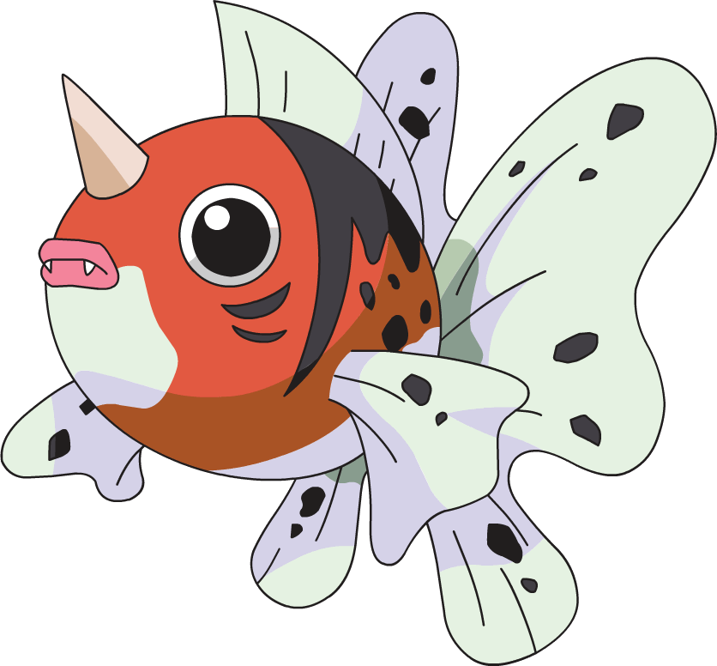

DEBUG DAY
PROBLEM FOUR
#the goal of this program is to sum all of the digits of a user inputted number together
#getting input
x = int(input("Please enter a number: "))
sum = 0
#looping while the number still has digits
while x > 0:
sum = x % 10
x /= 10
#printing the sum
print(sum)

Slide 7

DEBUG DAY
PROBLEM FIVE
#code to detect if a string is a palindrome
word = input("Type in a word to see if it's a palindrome.")
isPalindrome = True
for i in range(0,len(word)):
if(word[i] == word[len(word)-1]):
isPalindrome = True
else:
isPalindrome = False
if isPalindrome:
print("Is a palindrome.")

Slide 8
DEBUG DAY
YOU SURVIVED!
Congratulations on escaping debug jungle with your lives!

